Slide 1
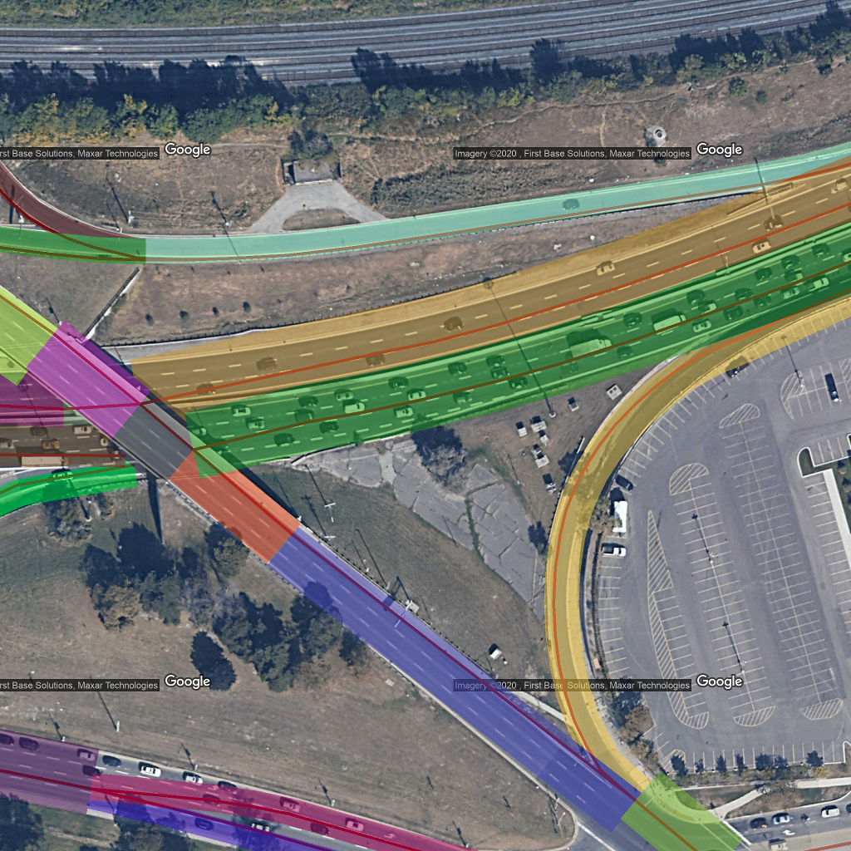
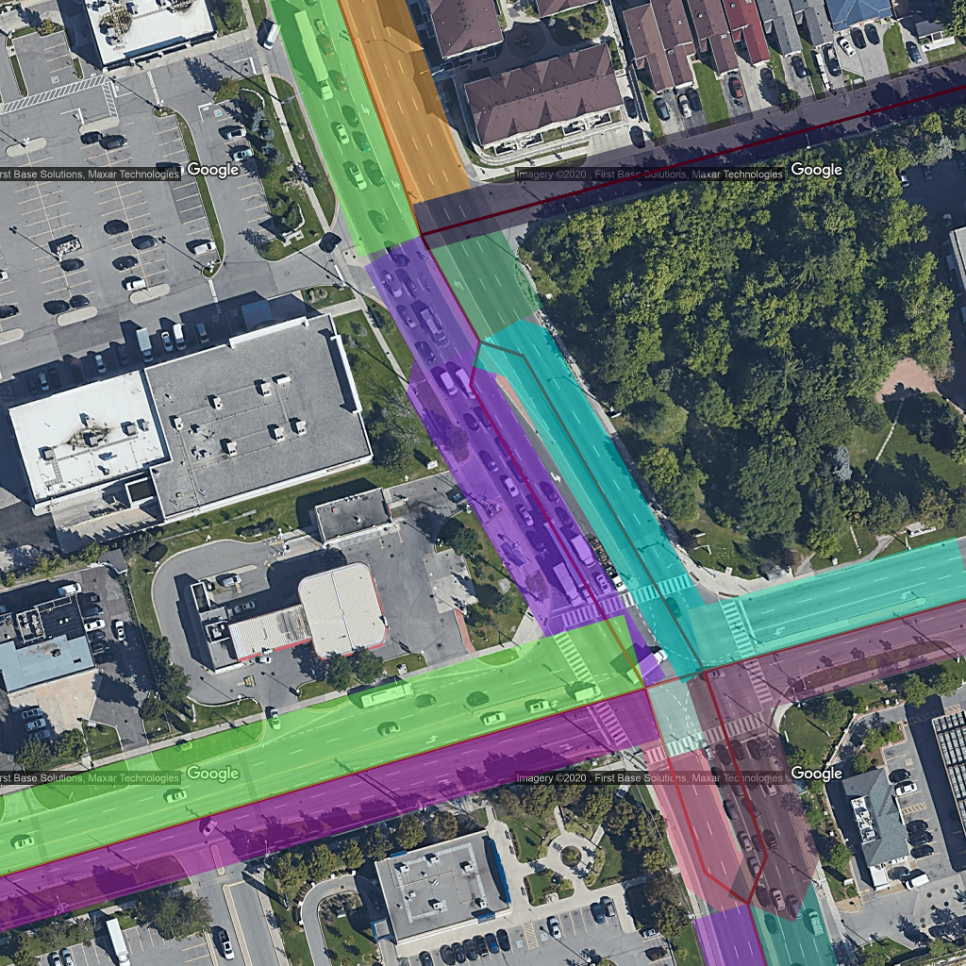
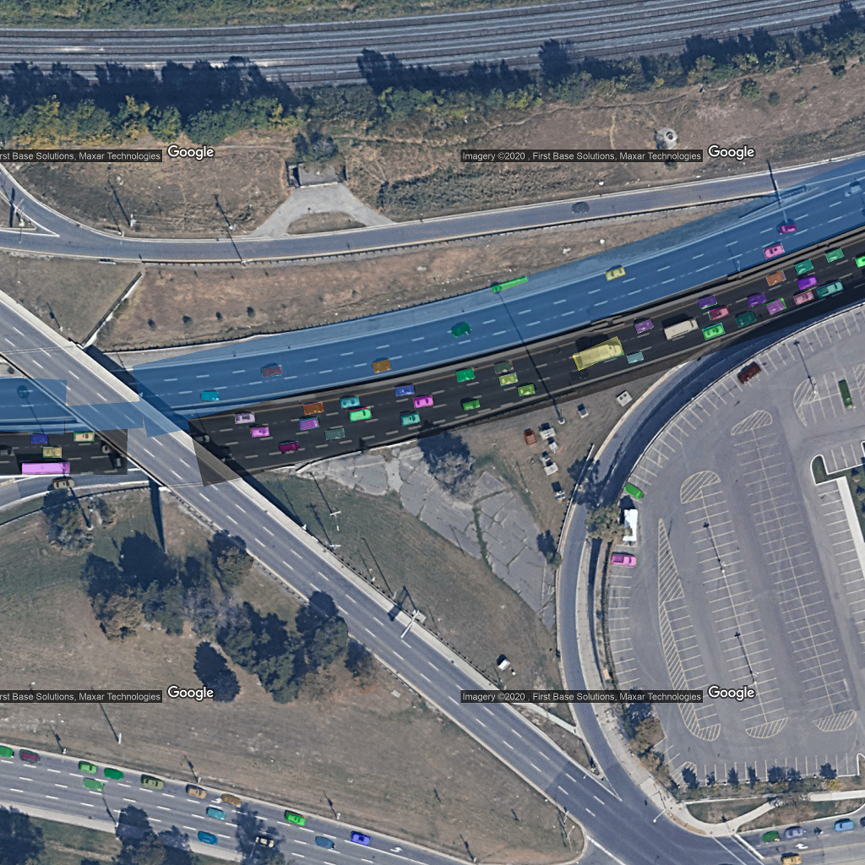
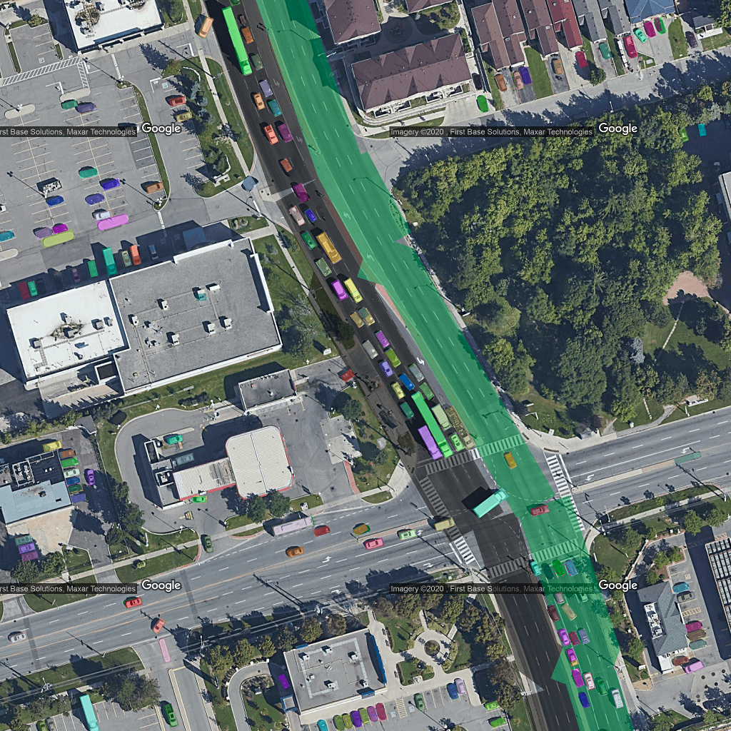

Highway Main road
Highway Main road
Validate AADT

Slide 2
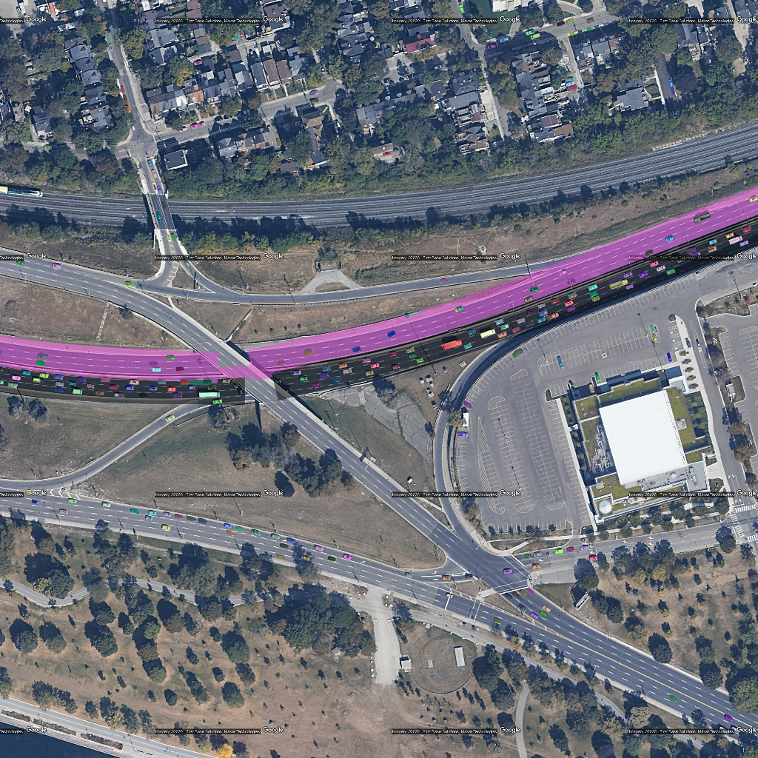
2048*2048
Road length: ~300m
4096*4096
Road length: ~500m

Slide 3
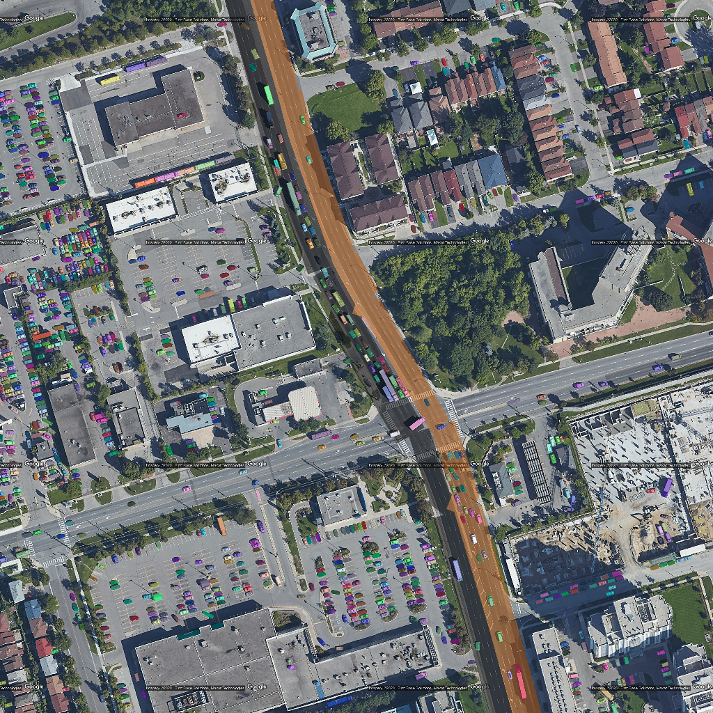
2048*2048
Road length: ~270m
4096*4096
Road length: ~480m

Slide 4
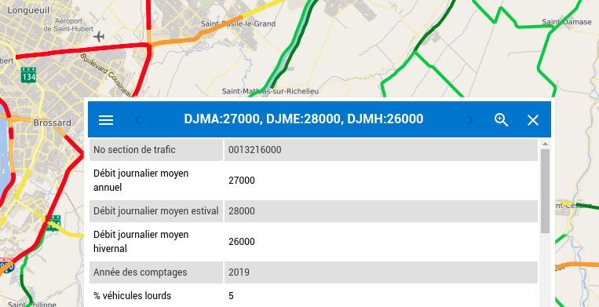
Quebec Traffic Count (3871 valid records)

Slide 5
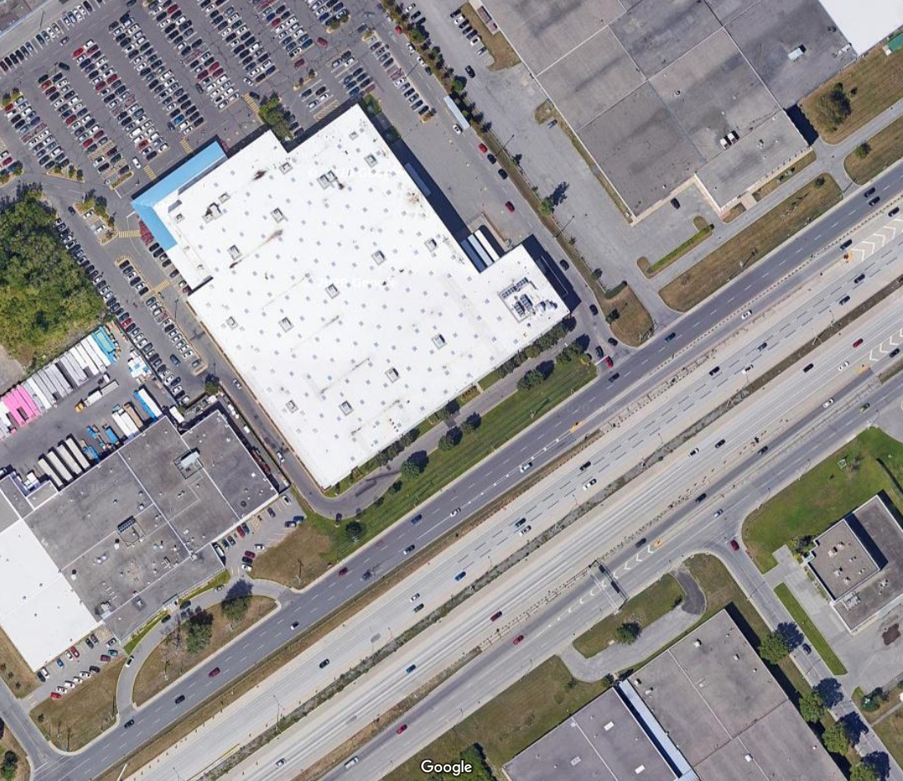
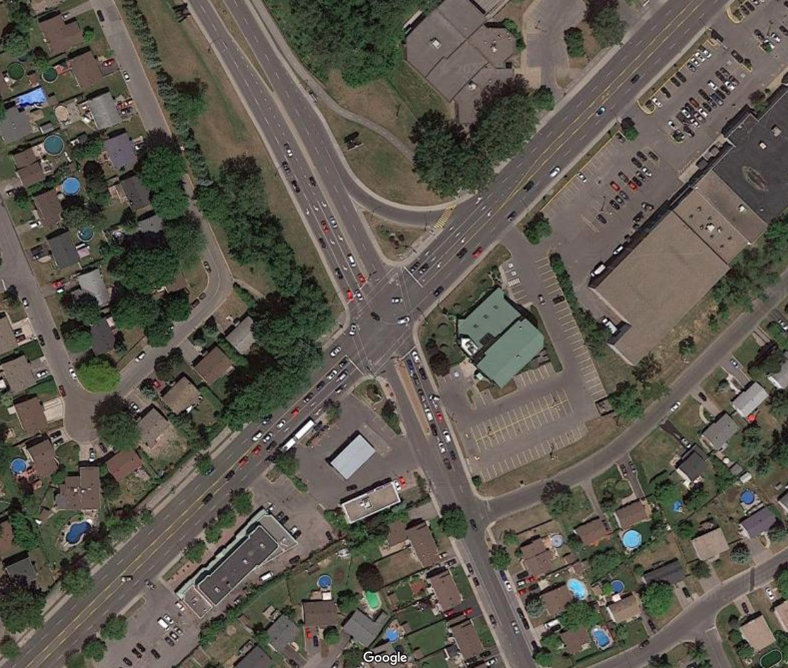
Google maps images
2019/08/19
2018/06/02

